Slide 1
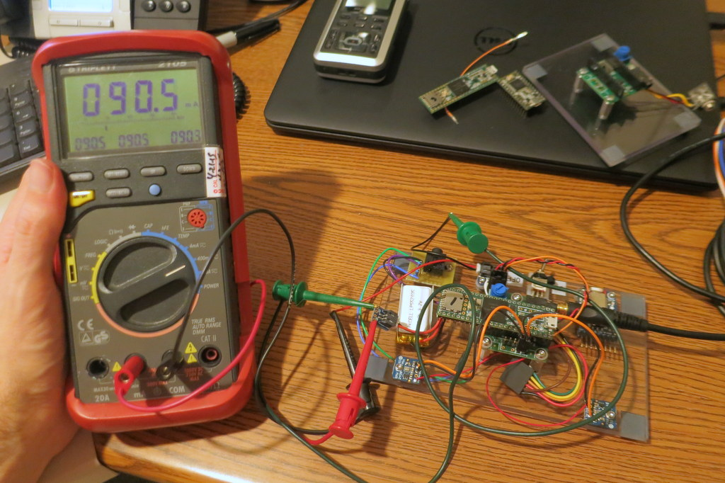
Too Much
Current Draw?

Slide 2
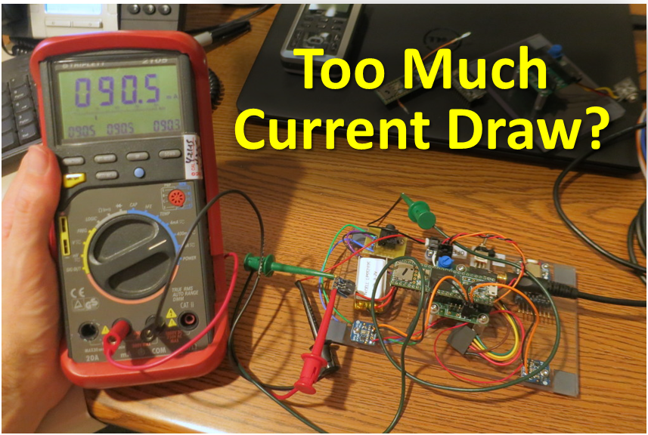

Slide 3
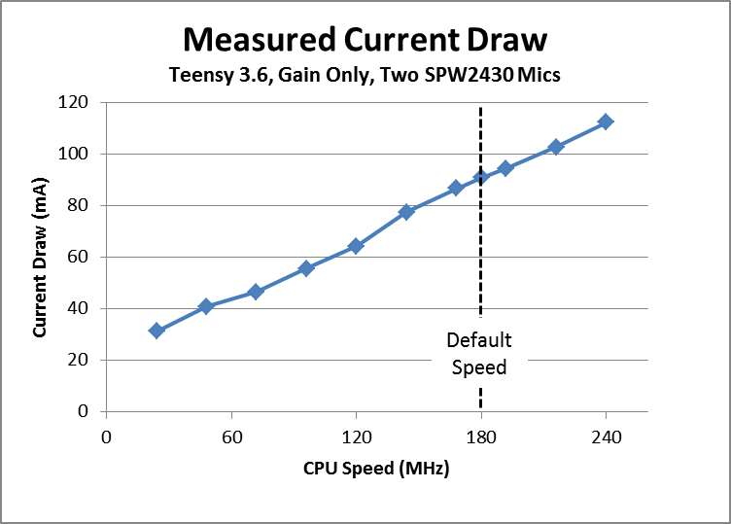

Slide 4
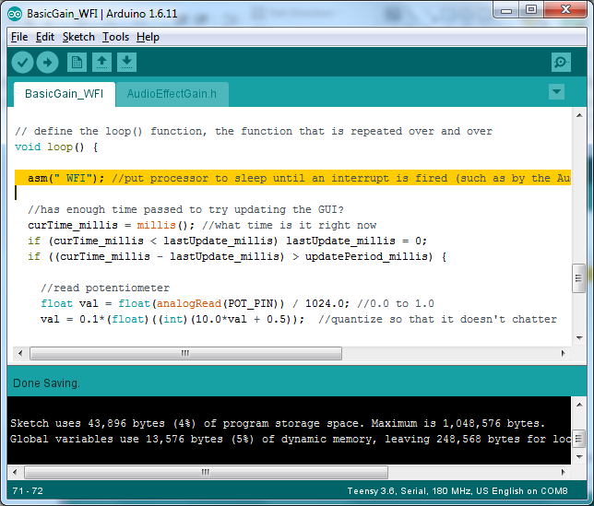

Slide 5
Input | Current Draw (mA) |  | mA/MHz |  | Compare
CPU Speed (MHz) | Baseline Software | Using asm(" WFI") | Baseline Software | Using asm(" WFI") | WFI vs delay()
240 | 112.4 | 67.4 | 0.47 | 0.28 | 60%
216 | 102.8 | 62.4 | 0.48 | 0.29 | 61%
192 | 94.5 | 58.2 | 0.49 | 0.30 | 62%
180 | 90.9 | 57.3 | 0.51 | 0.32 | 63%
168 | 86.7 | 55.4 | 0.52 | 0.33 | 64%
144 | 77.5 | 50.4 | 0.54 | 0.35 | 65%
120 | 64.3 | 44.3 | 0.54 | 0.37 | 69%
96 | 55.5 | 39.2 | 0.58 | 0.41 | 71%
72 | 46.6 | 34.5 | 0.65 | 0.48 | 74%
48 | 40.8 | 33 | 0.85 | 0.69 | 81%
24 | 31.3 | 27.7 | 1.30 | 1.15 | 88%

Slide 6
Input | Current Draw (mA) |  | Compare
CPU Speed (MHz) | Baseline Software | Using asm(" WFI") | WFI vs Baseline
240 | 112.4 | 67.4 | 60%
216 | 102.8 | 62.4 | 61%
192 | 94.5 | 58.2 | 62%
180 | 90.9 | 57.3 | 63%
168 | 86.7 | 55.4 | 64%
144 | 77.5 | 50.4 | 65%
120 | 64.3 | 44.3 | 69%
96 | 55.5 | 39.2 | 71%
72 | 46.6 | 34.5 | 74%
48 | 40.8 | 33 | 81%
24 | 31.3 | 27.7 | 88%

Slide 7
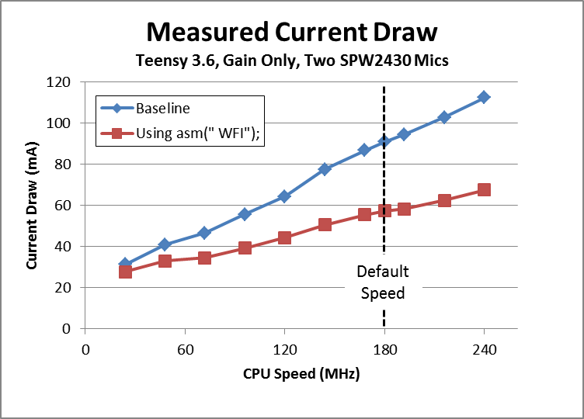

Slide 8
Input | Estimated Battery Life (Hrs)
Capacity (mA-hr) | 180 MHz delay() | 180 MHz asm(" WFI");
100 | 1.10 | 1.75
150 | 1.65 | 2.62
350 | 3.85 | 6.11
500 | 5.50 | 8.73
850 | 9.35 | 14.8
1000 | 11.0 | 17.5
1200 | 13.2 | 20.9
2000 | 22.0 | 34.9

Slide 9
